Slide 1
Methods for Artificial Intelligence
Alexander Jung, Computer Science/Aalto

Slide 2
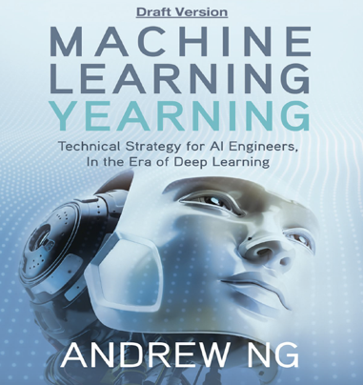

Reading Material
https://arxiv.org/abs/1805.05052
https://www.deeplearning.ai/machine-learning-yearning/

Slide 3
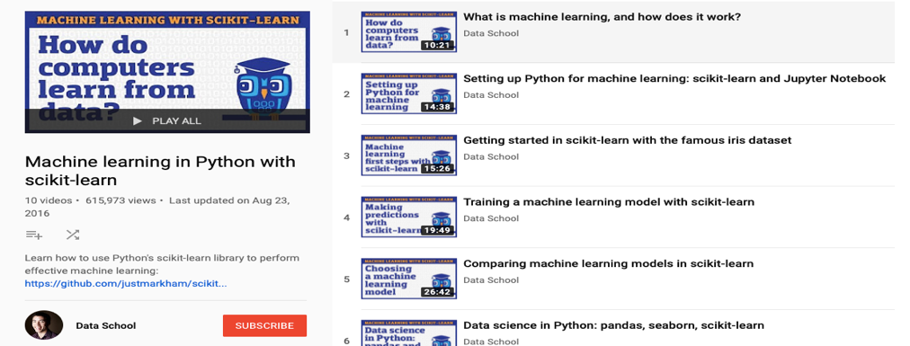
Some Video Material
https://www.youtube.com/playlist?list=PL5-da3qGB5ICeMbQuqbbCOQWcS6OYBr5A

Slide 4
(Artificial) Intelligence Involves (Machine) Learning
from Wikipedia:
“Among the traits that researchers hope machines will exhibit are
reasoning, knowledge, planning, learning,
communication, perception,….“

Slide 5
AI Principle (Engineer Perspective)
automatically choose (compute) optimal decisions to maximize a long-term reward

Slide 6
Machine Learning for AI
optimal decisions/planning require insights
ML extracts high-level insights from raw data
ML is low-level AI

Slide 7
What is Machine Learning?
computer programs (algorithms) which use historic data to learn how to make predictions

Slide 8
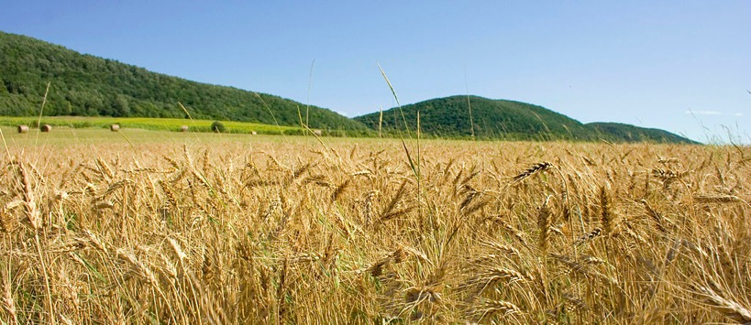
When to Harvest?

Slide 9
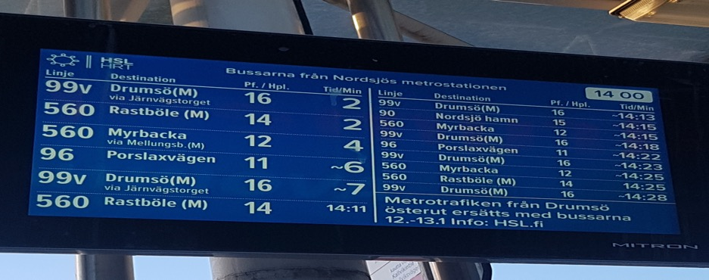
When will my bus arrive?

Slide 10
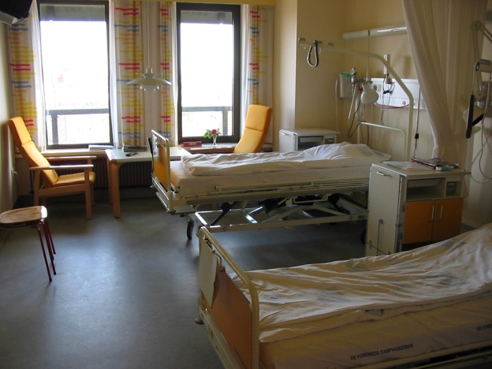
Is Everything OK? Where is the Patient?

Slide 11
Say “OK Google…“
https://www.youtube.com/watch?v=p5DVeDWtA5U

Slide 12
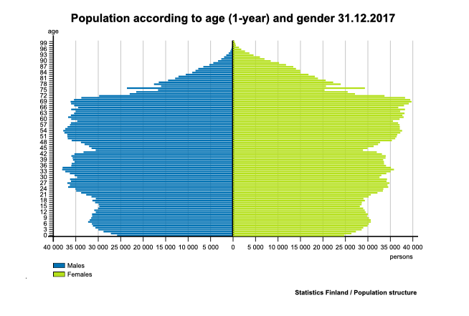
Age Distribution in Finland
old
young

Slide 13
What are Laws of Motion?
https://users.aalto.fi/~junga1/AppleFalling.mp4

Slide 14
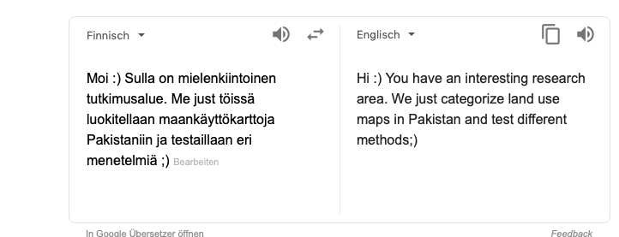
I still don’t speak Finnish ☹

Slide 15
Reliable AI
How much can we trust the prediction ?

Slide 16
Understandable AI
why this particular prediction?
e.g.: automated decision for KELA benefits
decisions require detailed justification based on law

Slide 17
Privacy Preserving AI
how to learn from data without revealing sensitive data?

Slide 18
In a Nutshell
ML methods fit (complicated) models to (tons of) data

Slide 19
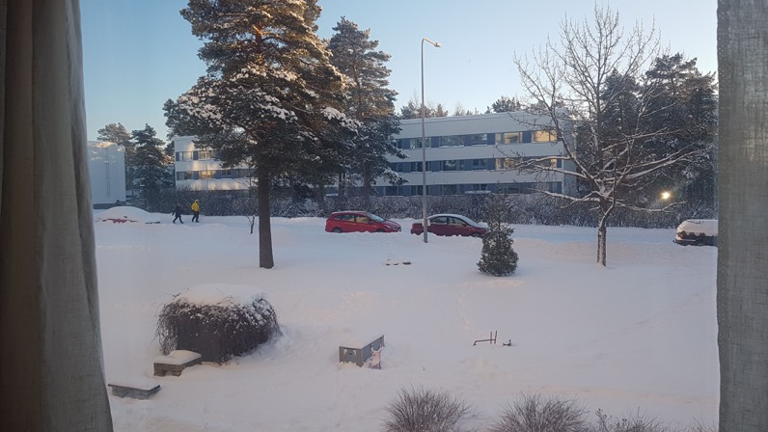
Nice Ski Day Ahead!

Slide 20

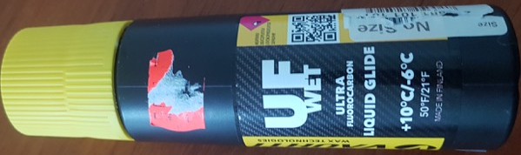
A ML Problem
plan a decent ski trip
which wax should I use?
depends on temperature during day
know the min temperature (its 07:00 am)
what will be max temperature?

Slide 21
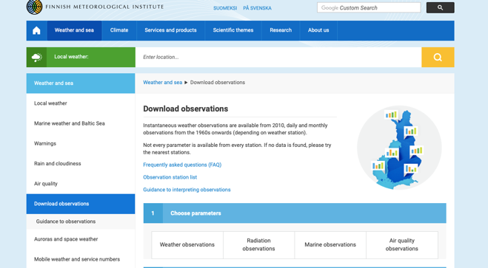
Data
https://en.ilmatieteenlaitos.fi/download-observations#!/

Slide 22
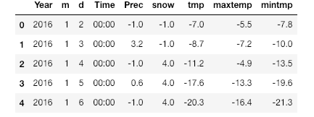
Historic Data
data point

Slide 23
Model
hypothesis: linear relation between min and max tmp
y = 3 x
y = 2 x
max temp. y
y = 1 x
min temp. x

Slide 24
Fitting the Model to Data
fit linear predictor y’=h(x) by minimizing mean squared error
historic data
linear predictor y’ = w*x
max temp y
tunable weight w
min temp x

Slide 25
How To Fit ?

Slide 26
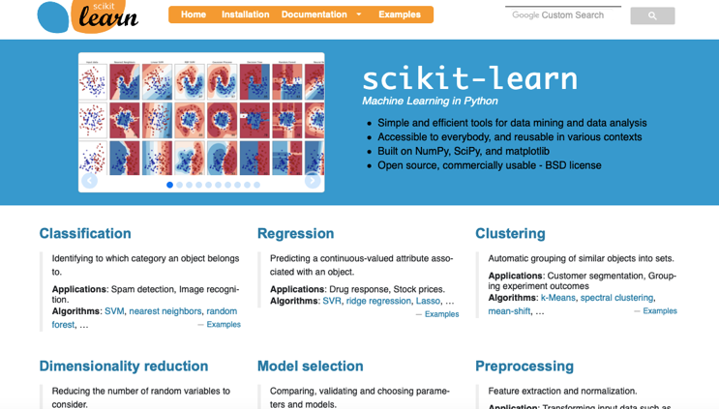
ML Methods Available in Python/MATLAB/R/…
https://scikit-learn.org/stable/

Slide 27
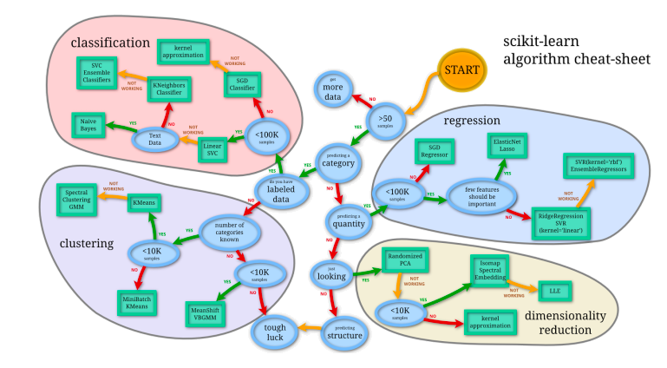
Python Cheat Sheet

Slide 28
Elements of Machine Learning

Slide 29
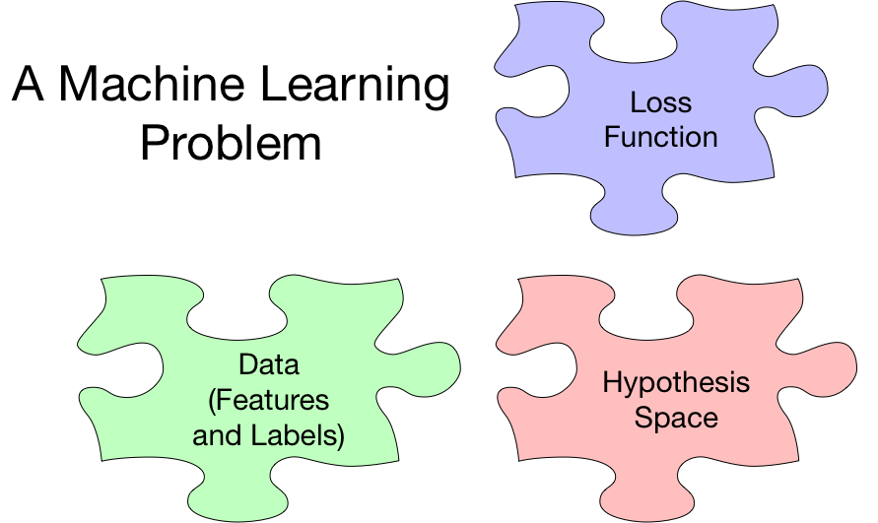

Slide 30
The Data

Slide 31
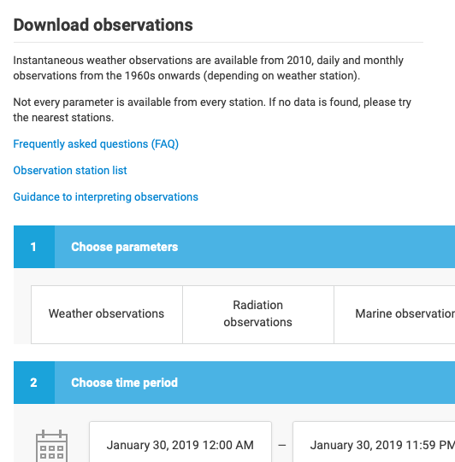

Data

Slide 32
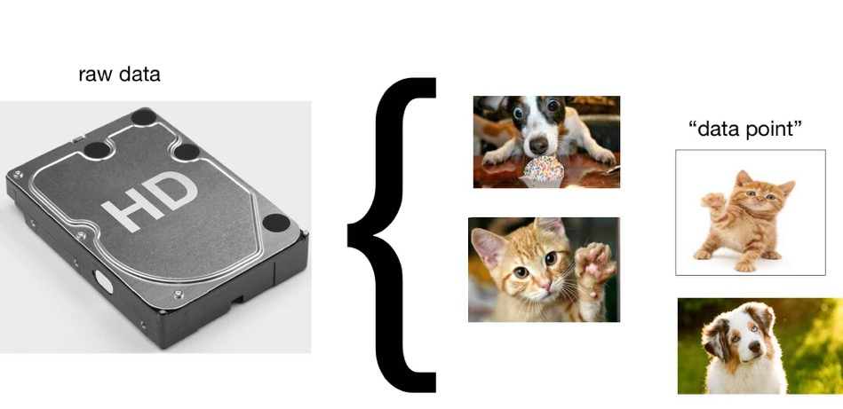
Data Points
break raw data into atomic pieces (chunks)
of data, e.g., individual files stored on hard disk

Slide 33
Data Points

Slide 34
Features for Image Data

Slide 35
Features for Time Signals

Slide 36
Features for Text
consider simple language with vocabulary {“have”, “a”, “good”, “great”, “day”}
represent words by ”one-hot encoding”
“have”=(1,0,0,0,0); „a“=(0,1,0,0,0), …., „day“=(0,0,0,0,1)
what could be feature vector of text “have have a good great day”?

Slide 37
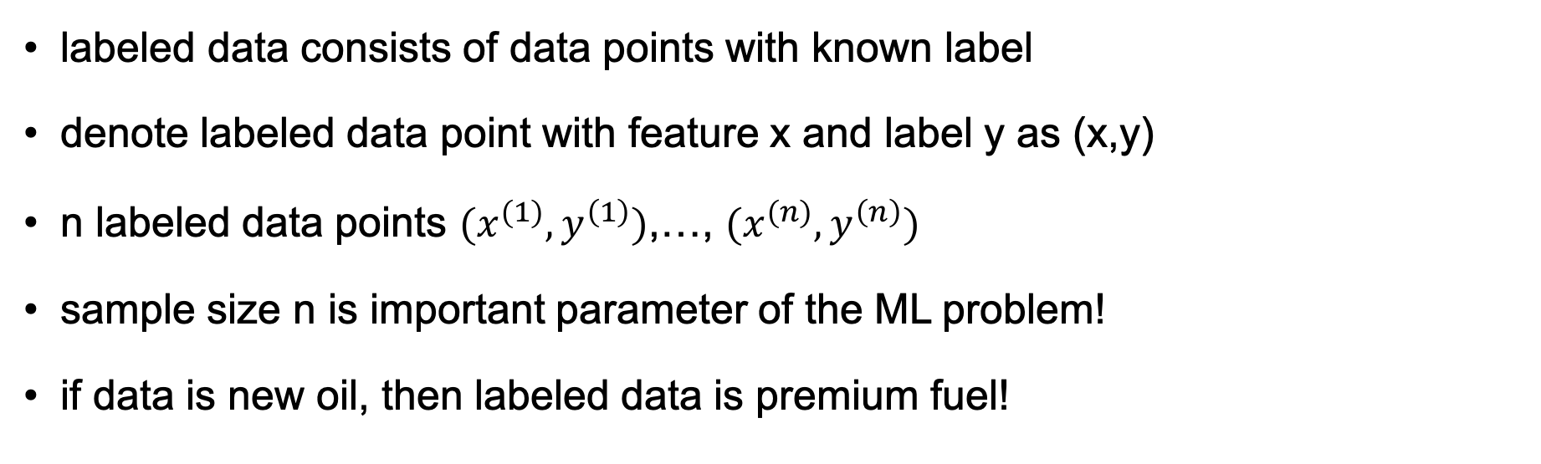
Labeled Data
labeled data consists of data points with known label
denote labeled data point with feature x and label y as (x,y)
n labeled data points $(x^{(1)},y^{\left(1\right)})$,…, $(x^{(n)},y^{\left(n\right)})$
sample size n is important parameter of the ML problem!
if data is new oil, then labeled data is premium fuel!

Slide 38

How To Get Labeled Data?
you can buy human labelling workforce!

Slide 39
Labeled Data
label

Slide 40
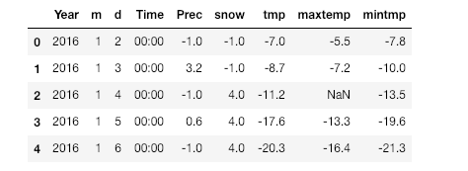
Missing Data
there are ML “autofill” tools known as “data imputation”

Slide 41
Labeled Data
“no cat”
”cat”
”cat”
“no cat”

Slide 42
Classification Problem
will max temp today be more than 0 or not ?

Slide 43

Classification Problem
does image on the left show “cat” or “no cat” ?
we can encode this by defining label of an image as y=1 if it shows cat and y=-1 if not
how can we get the true label y for an image?

Slide 44
Regression Problem
what will maxtemp be today (mintmp was -5 )?

Slide 45
Regression vs. Classification
AI engineer defines what the label is !
numeric label (e.g., max temp) yield regression problems
discrete label (e.g., “cat” vs. “dog”) yields classification
distinction between regression and classification is blurry!
“cat” vs. “dog” classification can be modeled as regression problem with numeric label y=“confidence that image shows rather cat than dog”

Slide 46
The Data – Wrap Up
collection of atomic data units “data points”
data point characterized by features and labels
features are quantities that can be determined easily
labels are difficult to determine (requires human labor)
ML methods guess label based on features

Slide 47
Hypothesis Space (“Model”)

Slide 48
Hypothesis Space
need hypothesis (model) relating features (input) and label (output)
represent hypothesis as map or function h(x)
input features x and output predicted label h(x)
other names for hypothesis map are
“predictor” for numeric labels (e.g., temperature next day)
“classifier” discrete labels ( e.g., image shows ”cat” or “dog”)

Slide 49
“Hypothesis”/”Predictor”/”Classifier” = Map from Features to Labels
map h(.)
features x
predicted label y’=h(x)
choose h(.) s.t. “predicted label $≈$ true label”

Slide 50

Example of a Predictor
map h(.)
optimal candidate
“Kalle Koivunen”

Slide 51
Example of a Predictor
map h(.)
costumer request
problem category

Slide 52
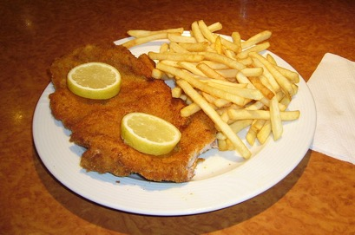
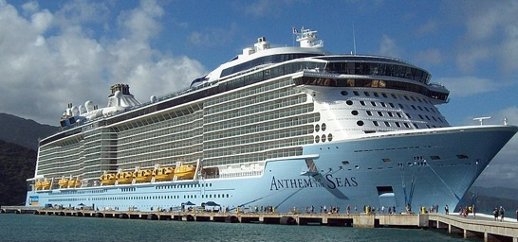
Example of a Predictor
current operational
data of cruise ship
Schnitzel demand
at next dinner?
map h(.)
from Wikimedia Commons
from Wikimedia Commons

Slide 53
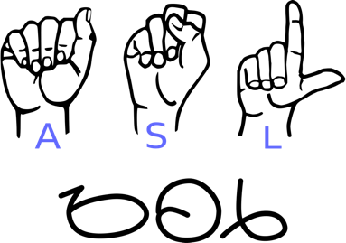
Example of a Predictor
sequence of gestures
sentence
map h(.)
“Please google …“
from Wikimedia Commons

Slide 54
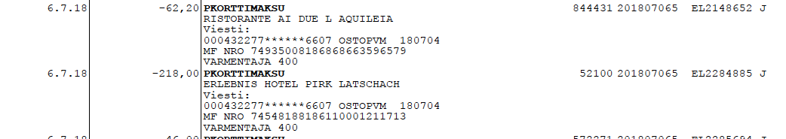
Example of a Predictor
Transaction
map h(.)
“No Money
Laundry”

Slide 55
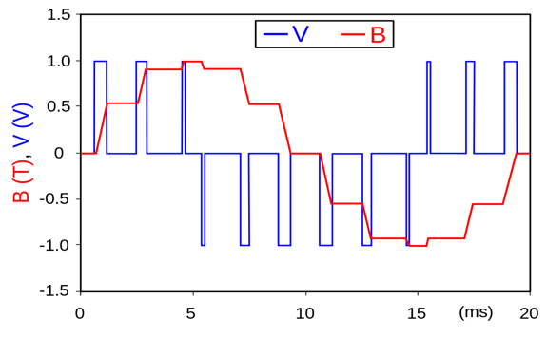
Example of a Predictor
measurements
risk of fault
within next week
map h(.)
60 %

Slide 56


Example of a Predictor
map h(.)
“Fleetwood Mac –
Don’t Stop“

Slide 57
From Predictions to Actions
this module focuses on ML methods that deliver predictions
predictions are further used e.g. to inform actions/decisions
actions then result in new data (produced by costumers)
results in a feedback loop “The Virtuous AI Cycle”

Slide 58
The Virtuous AI Cycle
AI-BASED
PRODUCT
improves
attracts
generates
DATA
USERS

Slide 59
How to Implement Predictors?
predictor is a map h(x)
maps feature x to a predicted label y’
computing a prediction amounts to evaluation the map
sounds trivial but can be challenging
how can we efficiently represent a map h(x) ?

Slide 60
Linear Predictors (Linear Regression)
label y
predictor h(x) = w * x
w=2
tunable weight w
w=1
feature x

Slide 61
Linear Predictors
widely used
lot of engineering effort to make ML methods efficient
hardware (GPUs) is tailored to linear methods
linear ML methods are a mature technology
can be used directly only with numeric features (vectors)
how to apply it to text ?

Slide 62
Decision Trees
feature x > w1 ?
tunable weights w1,w2,w4
no
yes
predictor map h(x)
x > w2 ?
x > w3 ?
no
yes
no
yes
y’=-5
y’=-2
y’=4
prediction y’=10

Slide 63
Decision Trees for Text
does x contain word w1?
yes
feature x is a tweet
no
tunable weights w1,w2,w4
predictor map h(x)
x contains w2 ?
x contains w3?
no
yes
no
yes
y’=“news”
y’=“news”
prediction y’=”fake news!”
y’=“fake news!”

Slide 64
Decision Trees
predictions arise from sequence of elementary tests
tests (e.g. x>5?) provide explanation for prediction
predict “tmp=10” because of x>5 and x<20 ….
predict “benefit granted“ due to Fact 1 and Law 1 …

Slide 65
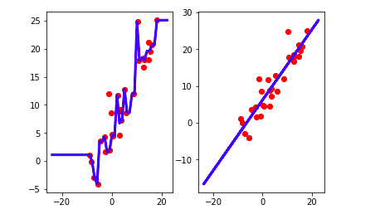
Decision Tree vs. Linear Predictor

Slide 66
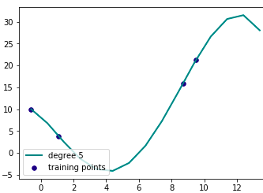
Polynomial Predictor
label y
y’ = h(x)
= w1 + w2*x + w3*x^2+w4*x^3
tunable weights w1,w2,w3,w4
feature x

Slide 67
Artificial Neural Networks
y’ = h(x)
w1
predicted label
w2
feature x
y’
tunable weights w1, w2, …

Slide 68
The Loss Function

Slide 69
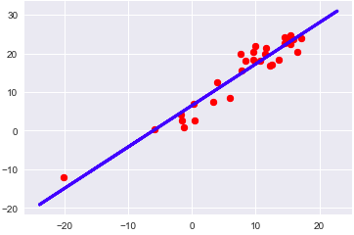
How Good is a Predictor?
define loss L(y,h(x)) of predicting true label y by y’=h(x)
y’ = h(x) = w *x

Slide 70
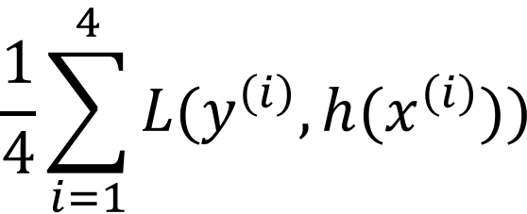
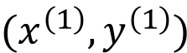
Average Loss (Empirical Risk)
y’ = h(x) = w*x
$$(x^{\left(1\right)},y^{\left(1\right)})$$
$$\frac{1}{4}\sum_{i=1}^{4}{L(y^{\left(i\right)},h(x^{\left(i\right)})})$$
label y
feature x

Slide 71
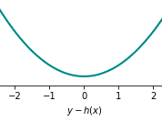
Squared Error Loss
L(y,h(x)) = (y-h(x))^2

Slide 72
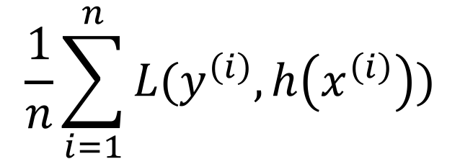
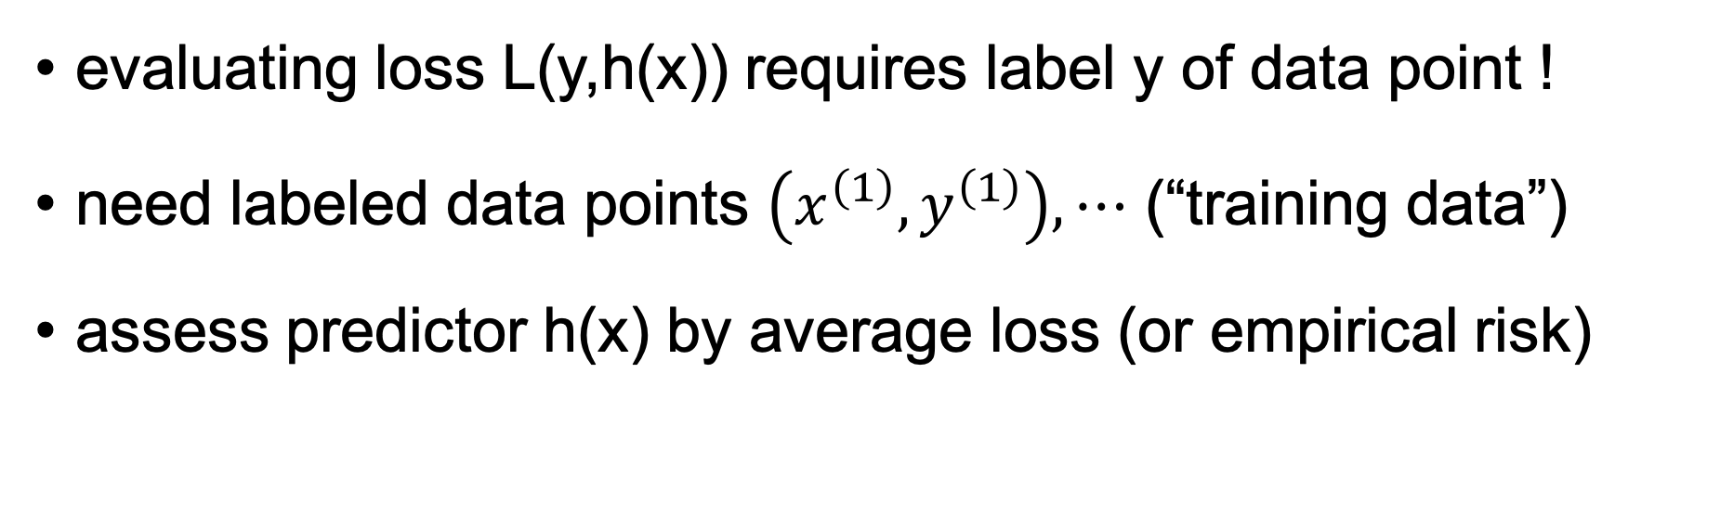
Training Data = Bunch of Labeled Data
evaluating loss L(y,h(x)) requires label y of data point !
need labeled data points $\left(x^{\left(1\right)},y^{\left(1\right)}\right),⋯$ (“training data”)
assess predictor h(x) by average loss (or empirical risk)
$$\frac{1}{n}\sum_{i=1}^{n}{L(y^{\left(i\right)},h\left(x^{\left(i\right)}\right))}$$

Slide 73
Choosing Loss Function
loss function is design choice (specified by AI engineer)
for numeric labels, squared error loss is widely used
sq. error has nice statistical and computational properties
for discrete labels, squared error loss is not well suited

Slide 74
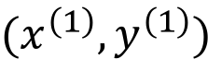
Squared Error Loss Bad for Binary Labels
h(x)
y=1
y=0
min temp x
$$(x^{\left(1\right)},y^{\left(1\right)})$$

Slide 75
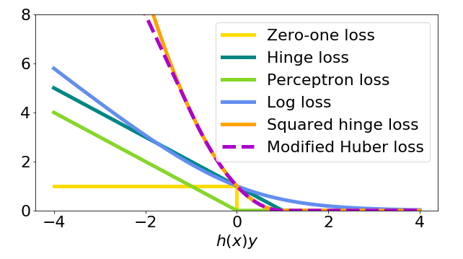
Loss Function for Binary Labels y=-1 or y=1

Slide 76
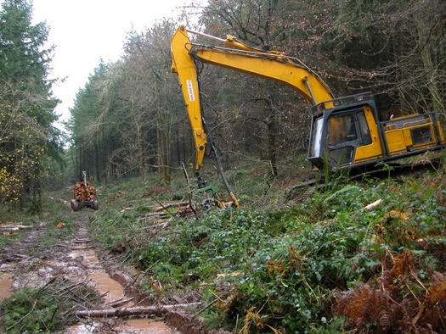
Loss Function for Binary Labels (y=-1 or y=1)
consider AI for harvester
camera snapshot is labeled y=1 (-1) if person present (absent)
loss L(y=1,y’=-1) should be very large since y=1, y’=-1 means there is person but AI misses her
loss L(y=-1,y’=1) can be small (AI sees person which is not there)

Slide 77
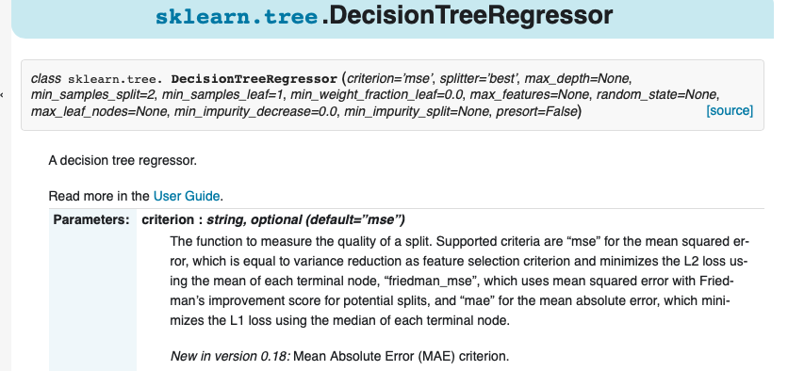
Loss Function Selection

Slide 78
Putting Together the Pieces
collect/measure/compute labeled data points
choose predictor (linear, tree, artificial neural net, …)
choose loss function
tune weights of predictor to minimize the average loss

Slide 79
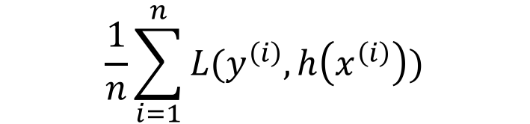
Learning/Training/Optimization/Model Fitting
$$\frac{1}{n}\sum_{i=1}^{n}{L(y^{\left(i\right)},h\left(x^{\left(i\right)}\right))}$$
linear regression
average loss on training data
deep net
tunable weights w of predictor h(x)

Slide 80
Model Selection

Slide 81
Model = Choice for Hypothesis Space
ML method/model = family of predictors with same structure
linear regression uses h(x) = w*x with tunable w
family of predictors constitutes the hypothesis space

Slide 82
Example: Linear Regression
consider data point having four features x1,…,x4
want to predict some numeric label y of data point
linear regression relates features and label via y’ = h(x) = w1*x1+w2*x2+w3*x3+w4*x4
different tuning weights w1,…,w4 yield different predictors !

Slide 83
Which Model Shall We Use?
decision trees
(deep) artificial neural nets
linear predictors
polynomial predictors
….

Slide 84
Nested Models
H_d = set of linear predictors which use first d features
H_1
H_2
H_3

Slide 85
Nested Models
define model H_d by set of polynomials with max. degree d
H_d included in H_e if d>=e
H_1
H_2
H_3

Slide 86
Nested Models
model H_d given by ANN with d hidden units
H_1
H_2
H_3

Slide 87
Training Error
consider particular model (e.g., polynomial predictor with max. degree d)
model constituted by maps with different choices for tuning weights w
choose weights by minimizing average loss (training error) over training set
if we use larger model, we can only reduce training error !
degree 5 polyn. can fit training data at least as good as degree 3 polyn.
why not simply using the largest possible model (polyn. with large degree)?

Slide 88
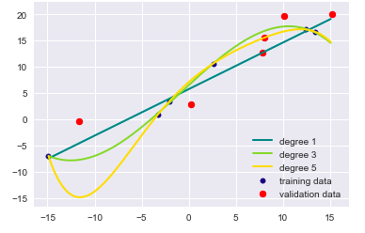
Overfitting
label y
feature x

Slide 89
Validate!
average loss E_train on training set can be misleading!
indeed, we optimize the predictor based on training set
after training, try out on different (validation) data!
compare training error E_train with validation error E_val
when E_train << E_val, ML model is overfitting !!!

Slide 90
Labeled Data
training
validation

Slide 91
Training and Validation Error

Slide 92
K-Fold Cross Validation
n labeled data points (assume n is integer multiple of K)
fold 1
…
fold K
K-fold CV involves K iterations: in each iteration choose
one fold as validation set; rest as training set
average the K validation errors

Slide 93
K-Fold CV with K=5

Slide 94
Diagnosing ML Methods
validation error
training error
desired accuracy

Slide 95
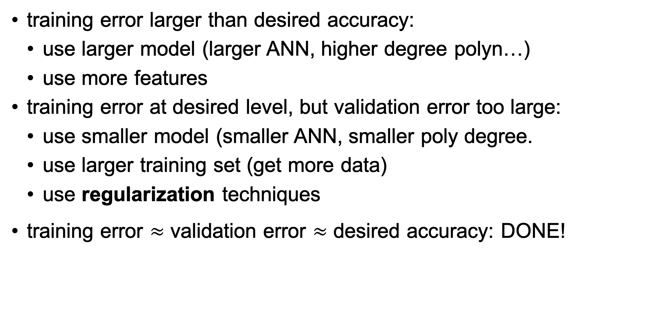
Diagnosis
training error larger than desired accuracy:
use larger model (larger ANN, higher degree polyn…)
use more features
training error at desired level, but validation error too large:
use smaller model (smaller ANN, smaller poly degree.
use larger training set (get more data)
use regularization techniques
training error $≈$ validation error $≈$ desired accuracy: DONE!

Slide 96
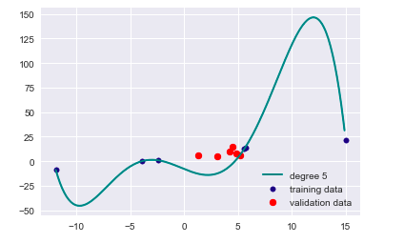
Regularization
consider polynomial predictor with max. degree 5
h(x) = w0 + w1 *x + w2*x^2 + …. w5*x^5

Slide 97

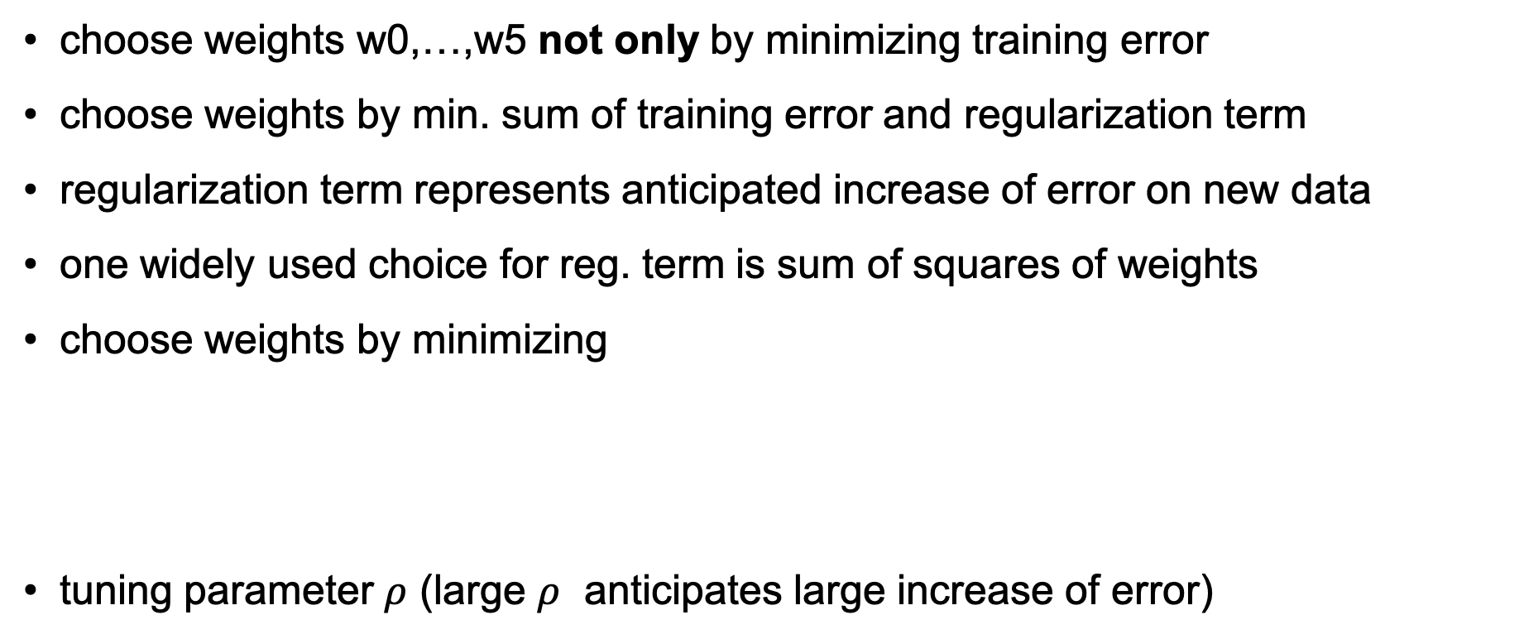
The Basic Idea of Regularization
choose weights w0,…,w5 not only by minimizing training error
choose weights by min. sum of training error and regularization term
regularization term represents anticipated increase of error on new data
one widely used choice for reg. term is sum of squares of weights
choose weights by minimizing
tuning parameter $ρ$ (large $ρ$ anticipates large increase of error)
$$\frac{1}{m}\sum_{i=1}^{m}{L(y^{\left(i\right)},h(x^{\left(i\right)})})+ρ{(w}_{0}^{2}+…+w_{5}^{2})$$

Slide 98
Lets get Hands Dirty!
get some data and define features and labels
choose ML model: linear, polynomial, ANN, decision tree
compute training and validation error
compare training, validation error with desired accuracy)
change model (enlarge/reduce model) and/or get more data
repeat

Slide 99
Clustering

Slide 100
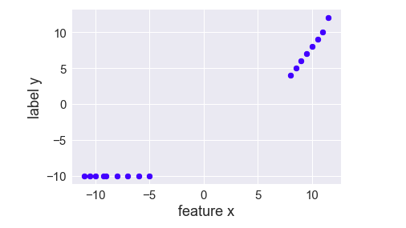
A Linear Prediction Problem
consider data points (x,y) with features x and label y
assume you want to use linear predictors to predict y from x

Slide 101
Clustering = Grouping Similar Data Points
how many cluster (groups)
do you see?

Slide 102
Two Main Flavors of Clustering
hard clustering:
each data point belongs to exactly one cluster
popular method: k-means
soft clustering:
data points belong to many clusters
data points have degree of belonging to particular cluster
popular method: Gaussian mixture models

Slide 103
Hard Clustering
cluster 1
cluster 2

Slide 104
Soft Clustering
cluster 1
Gaussian distribution
with mean m1 and cov. matrix C1
Gaussian distribution
with mean m2 and cov. matrix C2
cluster 2

Slide 105
Feature Learning

Slide 106
Long Vectors
consider data point represented as vector z of length D
what is D for a 1000 by 1000 greyscale image
what is D for a 5 sec recording of a song ?
what is D for a dictionary containing all English words?
what is D for a dictionary of English 5-grams ?

Slide 107
What is Bad About Long Feature Vectors?
computing with long vectors is time consuming
risk of overfitting
consider data points represented by vectors of length D
linear predictors overfit training data set smaller than D

Slide 108


Basic Idea
raw data
reconstruction
compress
reconstruct
features
map h(z) involves tunable weights w
choose weights w to ensure small reconstruction error z-z’

Slide 109
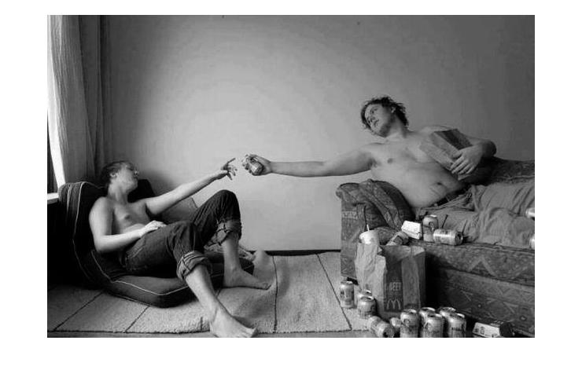

The Creation (Finnish)
raw data = 254820 pixels
reconstruction obtained from
17837 features

Slide 110
Linear Feature Learning
apply linear
map W
linear reconstruction
map R
raw data z
features x
z’
what is best choice for matrix W such that z’ close to z ?

Slide 111
Non-linear Feature Learning – “Autoencoder”
w1
raw data z
features x
reconstruction z’
w30
tunable weights w1,w2,….

Slide 112
Transfer Learning

Slide 113
Basic Idea
train ML method on different data
massive amounts of unlabeled data to pre-train ANN
small amount of high quality labeled data to fine-tune ANN
allows to compress raw data into pre-trained models

Slide 114
Model Based ML Methods

Slide 115
Model Based Machine Learning
consider data points with features x and labels y
interpret them as realizations of random variables
sequence of data points is a random process
data characterized by probability distribution

Slide 116
Condition on Data
specify joint distribution p(…) of all quantities in the model
quantities include: features, labels of data points and parameters
compute posterior distribution of variables given observed data
https://docs.pymc.io/notebooks/GLM-linear.html

Slide 117
Probabilistic Machine Learning
today at 07:00 am: mintmp=-10 maxtmp =?
compute posterior probability distribution p( hidden variables | data)

Slide 118
Two Challenges
Challenge1: how to get joint probability distribution p( data, hidden variables) ?
Challenge2: how to compute posterior distribution p( hidden variables | data) for extremely high-dim. distribution?

Slide 119
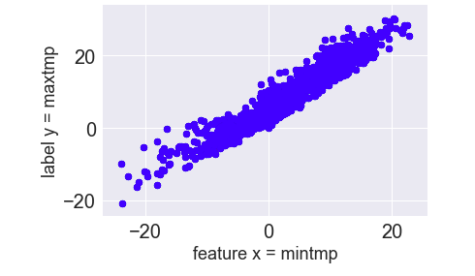
Learning Probability Distribution
what could be a good
choice for p(x,y) ?

Slide 120

Ready Made Tools
efficient methods for learning prob. distributions available
efficient methods for computing posterior p( hidden variables | data) available

Slide 121
Reinforcement Learning

Slide 122
Machine Learning vs. Reinf. Learning
”ordinary” machine learning methods consider data given
methods are passive; read in data → output prediction
reinforcement learning takes effect of predictions into account
predictions incur decisions/actions
decisions/actions influence the data which is observed next

Slide 123

Cleaning Robot

Slide 124
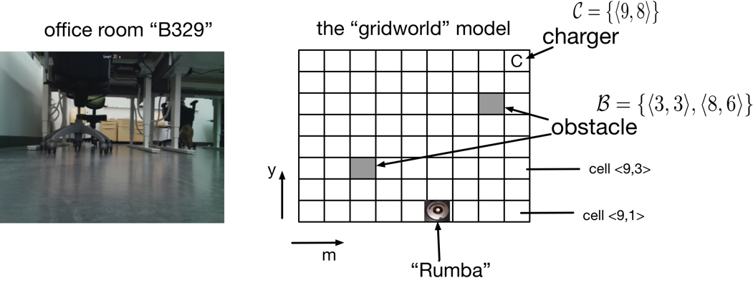
Office Room

Slide 125
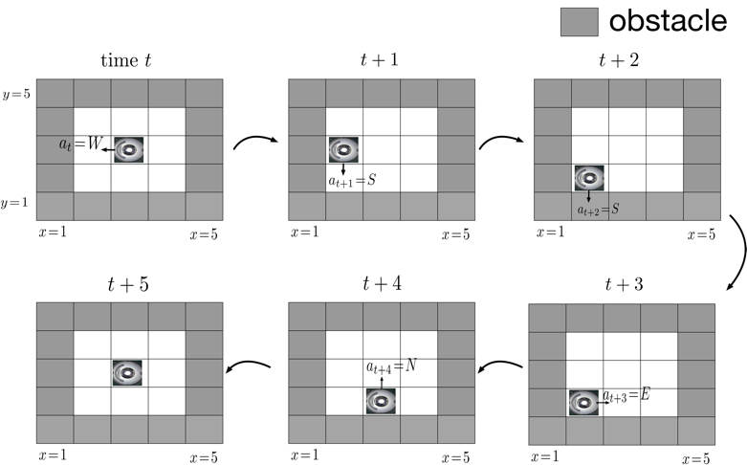
Actions
action y_t at time t is direction to move next

Slide 126
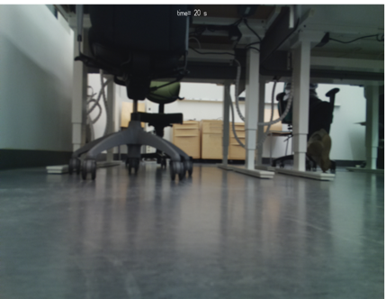
Reinforcement Learning Problem
given snapshot of onboard camera,
what is best direction to move next
features x = pixels of snapshot
label y = optimal direction to move next
We do not know the true label here!
We can only observe the effect of choosing
some direction!

Slide 127
Markov Decision Process
interaction between AI (cleaning robot) and environment (office room)
at time t, observe snapshot x_t
based on snapshot decide for next direction y_t
measure amount r_t of dust collected at time t
sequence x_1,y_1,r_1,x_2,y_2,r_2 modelled as a Markov decision process
MDP is a special type of random process

Slide 128
Optimal Policy
AI cleaning robot implements a policy h(x)
policy takes input x (snapshot) and outputs y (direction of next move)
policy map h(x) depends on tunable weights (like predictors !)
RL amounts to tuning h(x) such that reward is maximized
AI engineer defines what the “reward” is (e.g., amount of dust collected)

Slide 129
That’s It Folks!

